Slide 1
Homework 2 feedback
Make sure you think about how users can break your apps.
selectize = TRUE and multiple = TRUE allows users to make no selection!
In-code COMMENTS!
I want to know what you think you’re doing.
Send me the link to your GitHub repo!
library(scales)
If you might need an extension, go ahead and ask for it before midnight…

Slide 2
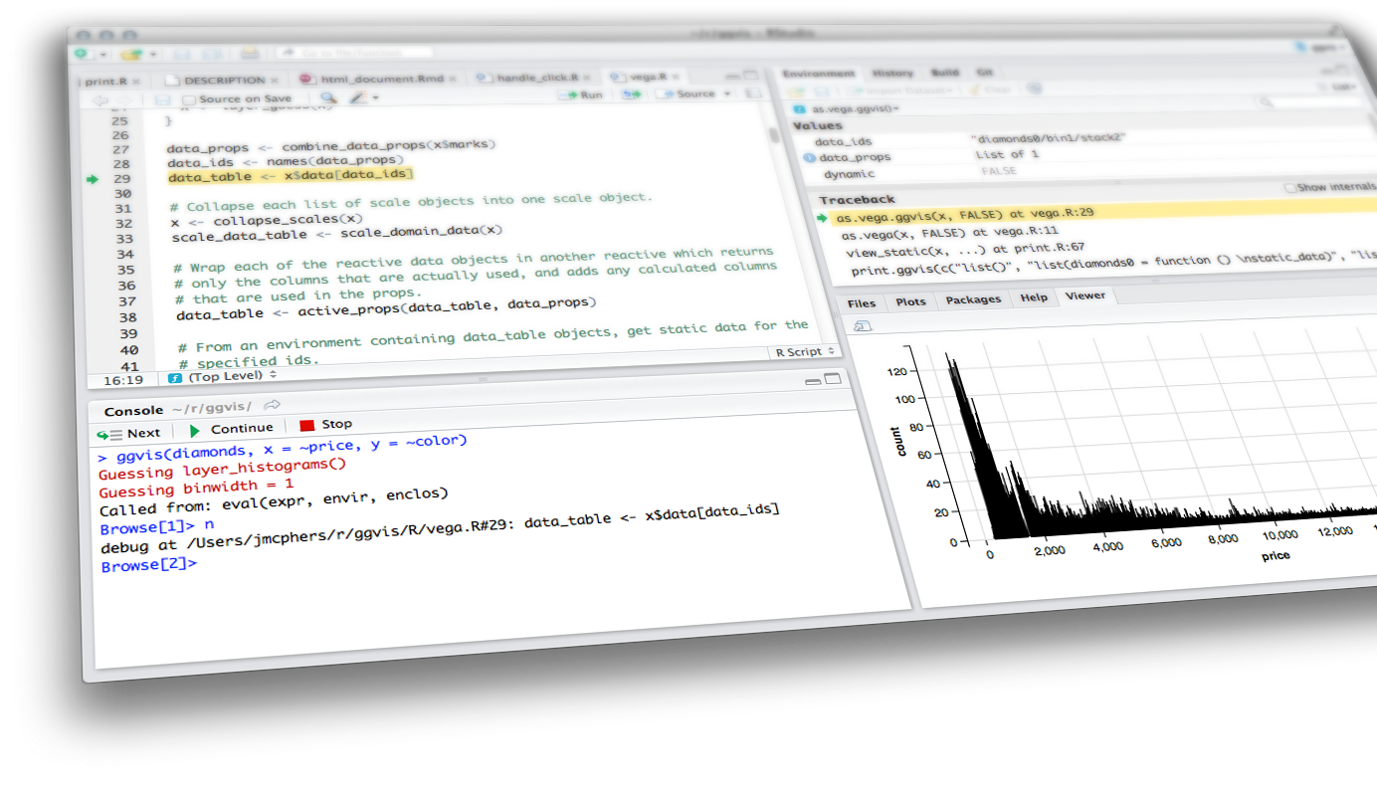

Connecting to Databases & API's
Shiny from

Slide 3
SQL
SQL Basics
Constructing a query
Functions
Where should I write SQL queries?
Building Connections
API’s
What are API’s and what do they do?
Making an API Call
Build your URL
Encode the URL
Process the content
Spatial Data with Esri
Geocode Example
Shiny Example

Slide 4
SQL Databases
Shiny from

Slide 5
“I rob banks use databases because its where the money data is.”
–Willie Sutton

Slide 6
SQL
the structured language

Slide 7
“SQL is a domain specific language used in programming and … data held in a relational database management system”
–Wikipedia

Slide 8
Structuring a query

Slide 9
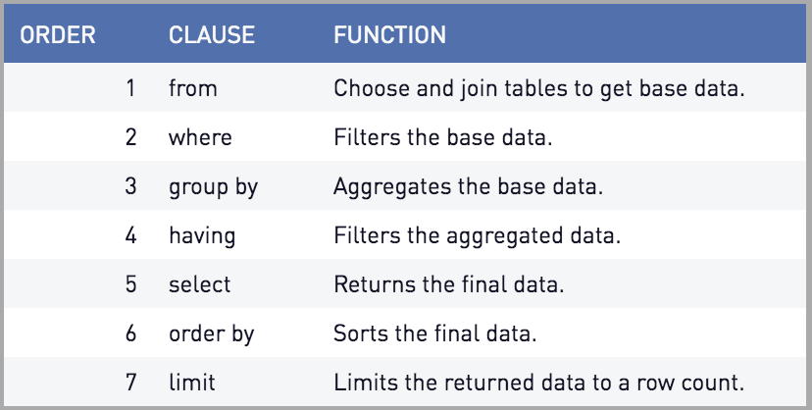
Queries
Source: periscope data

Slide 10

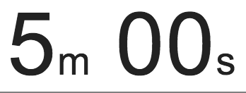
exercise
Run apps/wprdc_sql.R
Build a query that selects all of the crimes from the City of Pittsburgh Police Blotter
Hint 1: FROM would be the resource ID (1797ead8-8262-41cc-9099-cbc8a161924b)
Hint 2: The WPRDC uses a Postgresql backend
This means that anything that tables or columns that contain numbers or capital letters must be wrapped in quotes

Slide 11
Solution
SELECT * FROM "1797ead8-8262-41cc-9099-cbc8a161924b"

Slide 12
WHERE

Slide 13
BETWEEN … AND
BETWEEN
Grab Values between two other values, like IN but for numeric values
Works like < and >
SELECT column_name(s) FROM table_name WHERE column_name BETWEEN value1 AND value2;

Slide 14
IN statements
Useful for when you have an input that returns multiple
This works the same way %in% does in R
Checks to see if the value in the column matches any of the values in your list
SELECT column_name(s) FROM table_name WHERE column_name IN (value1, value2, ...)

Slide 15
exercise
Run apps/wprdc_sql.R
This time let’s target 311 requests: 76fda9d0-69be-4dd5-8108-0de7907fc5a4
Use the BETWEEN function as a WHERE filter to get 311 requests from from the last week.
Stretch goal: Use the IN Filter to only get requests of the Potholes, Weeds/Debris and Overgrowth call types.

Slide 16
Solution
SELECT * FROM "76fda9d0-69be-4dd5-8108-0de7907fc5a4" WHERE "CREATED_ON" BETWEEN (‘2021-03-04') AND ('2021-03-11')
SELECT * FROM "76fda9d0-69be-4dd5-8108-0de7907fc5a4" WHERE "CREATED_ON" BETWEEN ('2019-09-30') AND ('2019-10-06') AND "REQUEST_TYPE" IN (‘Potholes', 'Weeds/Debris', 'Overgrowth')

Slide 17
SELECT Functions and GROUP BY

Slide 18
SQL Functions
Sometimes you don’t just want the raw data
You want to aggregate the data in SQL before you load it into R
Use another server to do the heavy lifting so you don’t have to!
This is where

Slide 19
DISTINCT
DISTINCT()
Every unique value of a column.
Placing TWO columns inside will return unique instances of both columns:
DISTINCT(“REQUEST_TYPE”, “DEPARTMENT”)

Slide 20
MIN & Max functions
MIN()
Returns minimum value in a column(s)
MAX()
Return maximum value in a column(s)

Slide 21
Count, Average, Sum
COUNT() - returns the number of rows that your query returns
SELECT COUNT(column_name) FROM table_name
AVG() - returns the average value of a numeric column.
SELECT AVG(column_name) FROM table_name
SUM() - function returns the total sum - numeric columns only
SELECT SUM(column_name) FROM table_name

Slide 22
Group by
This is helpful for when you are doing any of the summary functions mentioned in the previous slides. (COUNT, SUM, MAX etc)
Any column that isn’t handled with a function should be included in your GROUP BY
SELECT column_name(s), max(column_name) FROM table_name WHERE condition GROUP BY column_name(s)

Slide 23
exercise
Run apps/wprdc_sql.R
Build a query that counts the number crimes by neighborhood from the City of Pittsburgh Police Blotter

Slide 24
Solution
SELECT
"INCIDENTNEIGHBORHOOD",
COUNT("CCR")
FROM "1797ead8-8262-41cc-9099-cbc8a161924b"
GROUP BY "INCIDENTNEIGHBORHOOD"

Slide 25
Where should I…
write my DB queries

Slide 26
SQL IDE’s
There are a bunch of SQL IDE’s each database provider has their own
If you’re in a workplace like mine with no standard then I suggest something like DBeaver because it connects to pretty much everything
If not, then use whatever comes standard with the platform

Slide 27
DB connections in R
Not always easy

Slide 28



Connecting
Database connectors require that your computer has the necessary software.
This will depend on what database type you are trying to connect to

Slide 29
Allowing handshakes
To setup database connections you will need to install the proper drivers.
The steps for this can be found here: https://db.rstudio.com/best-practices/drivers/
In general setup on Windows is a little bit easier since ODBC Data Source Administrator can be used
Your machine may already have drives installed if you’ve already installed SQL IDE’s such as: pgAdmin, DBeaver, or the MySQL Workbench

Slide 30
Storing credentials

Slide 31
File or environmental variable
You should never “hard code” your credentials into an app.
Instead you should store them as environmental variables, or in a hidden file that you ignore in the Git Repository
Why?
If something requires that you to login, we can assume that not just anybody should be able to access it.
Think of your credentials like your debit card and pin number

Slide 32
Establishing Connections
Each data base type has a different connection string and list of requirements.
More on connection strings: https://db.rstudio.com/best-practices/drivers/#connecting-to-a-database-in-r
conn <- dbConnect(odbc::odbc(), driver = "FreeTDS", server = "IP_or_HOST_ADDRESS", port = 1433, database = "DBName", uid = creds$un, pwd = creds$pw, TDS_Version = "8.0")

Slide 33
DB connections in Shiny

Slide 34
Database Pools
Its not nice to have a bunch of active connections to your databases
Pools are a great way to keep the connections ready
Keeps the connection ready to be checked out when needed
Closes the connection
Read more on using pools in Shiny: https://shiny.rstudio.com/articles/pool-basics.html

Slide 35
reactivePoll Review
Check function: is executed periodically and should always return a consistent value until the data changes
Note doesn’t return TRUE or FALSE, instead it indicates change by returning a different value from the previous time it was called
Value retrieval function: is used to re-populate the data when the check function returns a different value
We can use this in our apps to see if there’s new data, and if not simply keep what the user has been using, and if not, load the updated data

Slide 36
demo
example_dbi.R

Slide 37
API’s
Shiny from

Slide 38
Whats an API,
and what does it do?

Slide 39
API Examples
WPRDC
Census
Geocoders
Esri Online Datasets
Online Weather APIs
Sport Score API
And more!

Slide 40
API’s
Stands for: Application Programming Interface
There are many kinds of API’s
Web service
SOAP, XML-RPC, JSON-RPC, and REST
WebSocket
Library-based
Class-based
OS functions and routines
Object remoting
Hardware

Slide 41
REST API’s
End points - different URL’s that tell the webserver what data you would like
It’s essentially a website where you request different “end points”
There are 5 types of Requests you can make
GET (what we will use the most in this course)
POST (sometimes necessary for authentication, if you’re trying to write data somewhere)
PUT
PATCH
DELETE

Slide 42
Making an API Call

Slide 43
The Steps
Build your URL
Encode the URL
Process the content
Transform to a usable format

Slide 44
1. Building your Query
Many tools that make life easier:
Insomnia
Advanced REST Client
PostMan
And others…

Slide 45
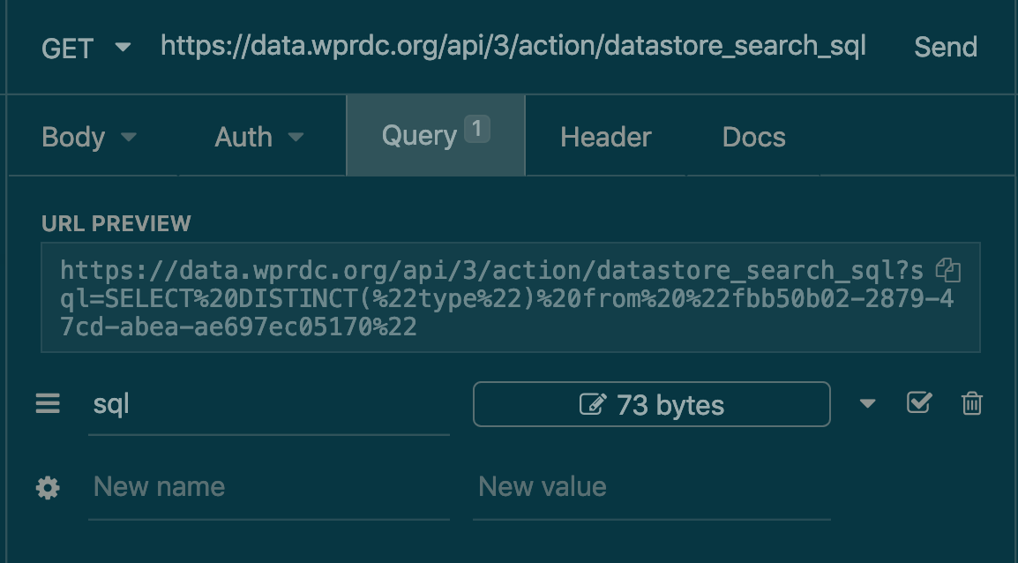
WPRDC API Call in Insomnia

Slide 46
The Steps
Build your URL
Encode the URL
Process the content
Transform to a usable format

Slide 47
demo
URLencode("someString", repeated = TRUE)

Slide 48
The Steps
Build your URL
Encode the URL
Process the content
Transform to a usable format

Slide 49
Content
Any API call will have multiple portions of it.
2 most important are:
Content
status_code

Slide 50
Getting to the content
Most API calls you will be making are GET requests.
Arguments you may need:
$something after fromJSON function
flatten=TRUE
get <- httr::GET(“encodedURL”)
c <- jsonlite::fromJSON(content(get, "text"))

Slide 51
Errors
Status codes indicate the result of the HTTP request.
100’s - info
200’s - success
300’s - redirection
400’s - client error (you messed up)
500 ’s- server error (something went wrong on their end, but you still could have messed up)

Slide 52
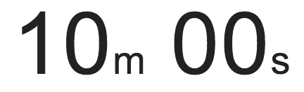
exercise
Open exercises/api_practice.Rmd and use the chunk labeled “Blotter”
Like last class generate an API call that downloads all of the data from the City of Pittsburgh Police Blotter
It might be easier to build the query in Insomnia or something else first
Stretch: After you have built a query that calls all of the data, add a group by or filter of some kind

Slide 53
Spatial Data

Slide 54
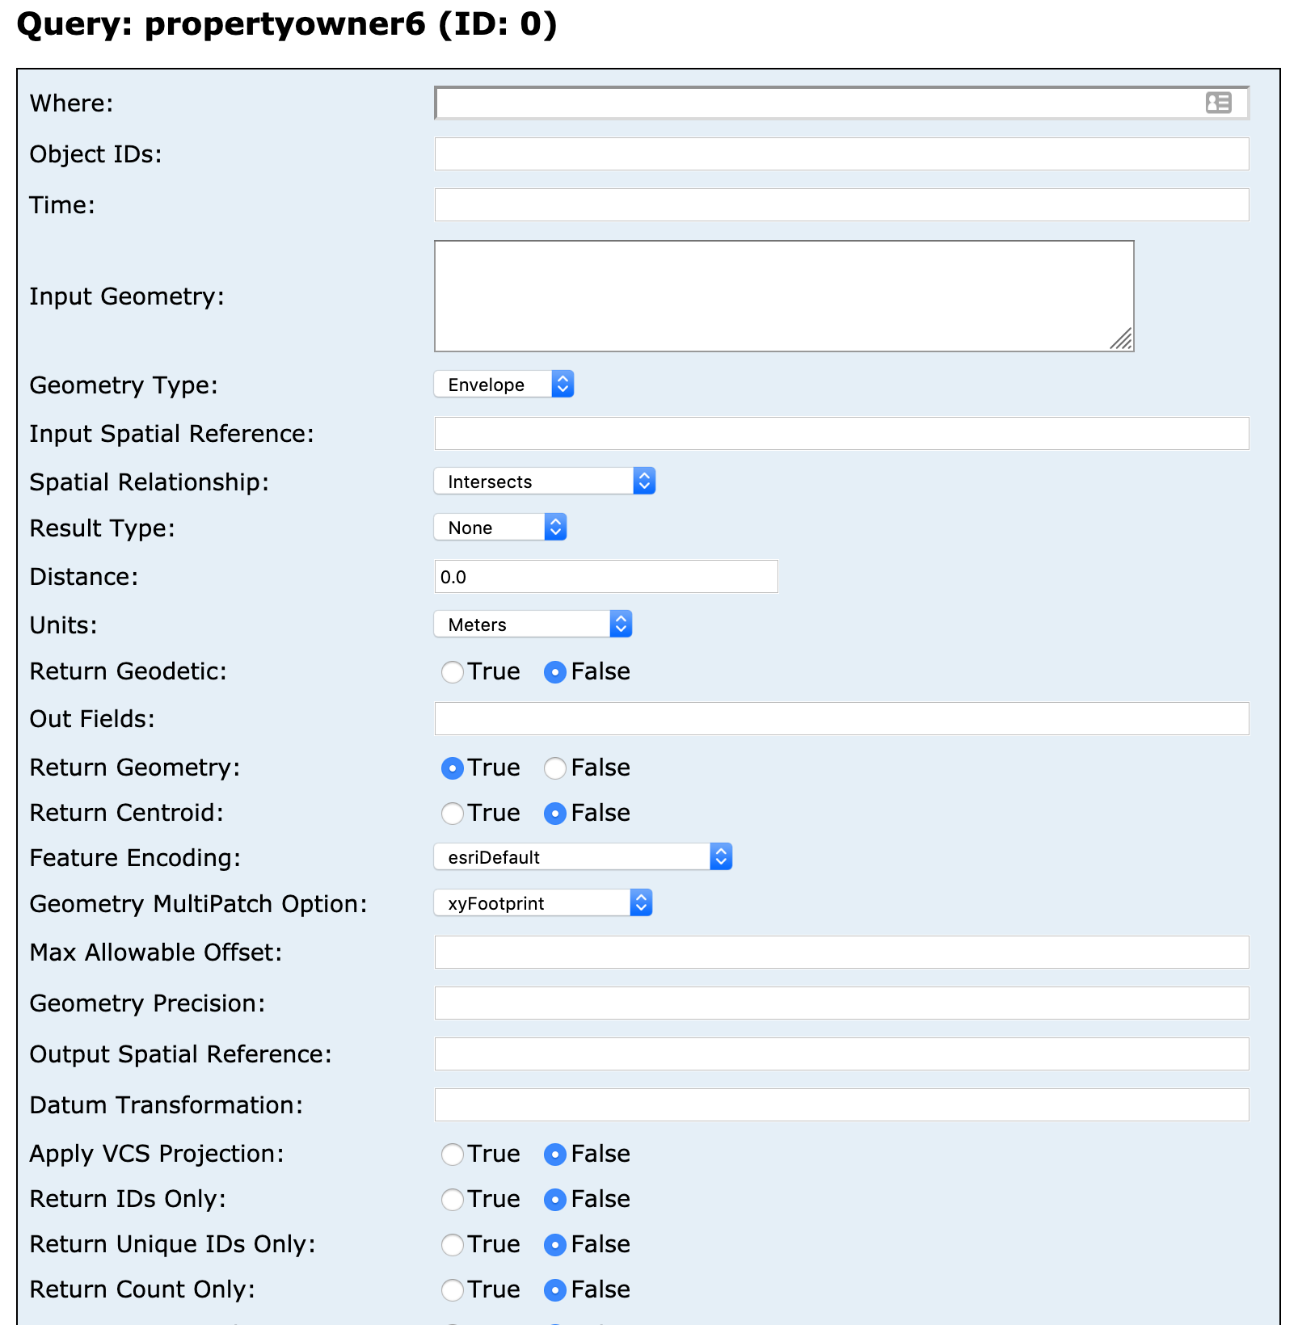
SQL like where statement to get one the data you want
Same as the select portion of a SQL query
Source: Allegheny County Esri API

Slide 55
Getting Spatial data
For ESRI API’s so long as your format is set to GEOJSON…
Its that easy
data <- readOGR("encodedURL")

Slide 56
exercise
Open exercises/api_practice.Rmd and go to the chunk labeled “Esri”
Look at the fields on the May 2019 Election layer from the Allegheny County Esri API: https://services1.arcgis.com/vdNDkVykv9vEWFX4/ArcGIS/rest/services/Allegheny_County_Polling_Places_May2019/FeatureServer/0
Get all of the polling places in just the City of Pittsburgh and load it into R from the URL

Slide 57
Solution
Solutions to both of todays exercises are in: api_practice_solutions.R

Slide 58
The Steps
Build your URL
Encode the URL
Process the content
Transform to a usable format

Slide 59
Other API’s

Slide 60
Other api’s
Not all (most) API’s will require you to do filtering or sql in them
This is mostly how Data Portal’s API’s work
Socrata Portals have a weird endpoint sql hybrid model using their SoQL framework: https://dev.socrata.com/docs/queries/
Typically API’s will have endpoints
You will need to read up on the Documentation on the API you are attempting to use.

Slide 61
Geocode
Example

Slide 62
demo
alco_geocode.R

Slide 63
Shiny
Example

Slide 64
demo
app/311_dashboard.R

Slide 65
API’s
Shiny from

